Slide 1
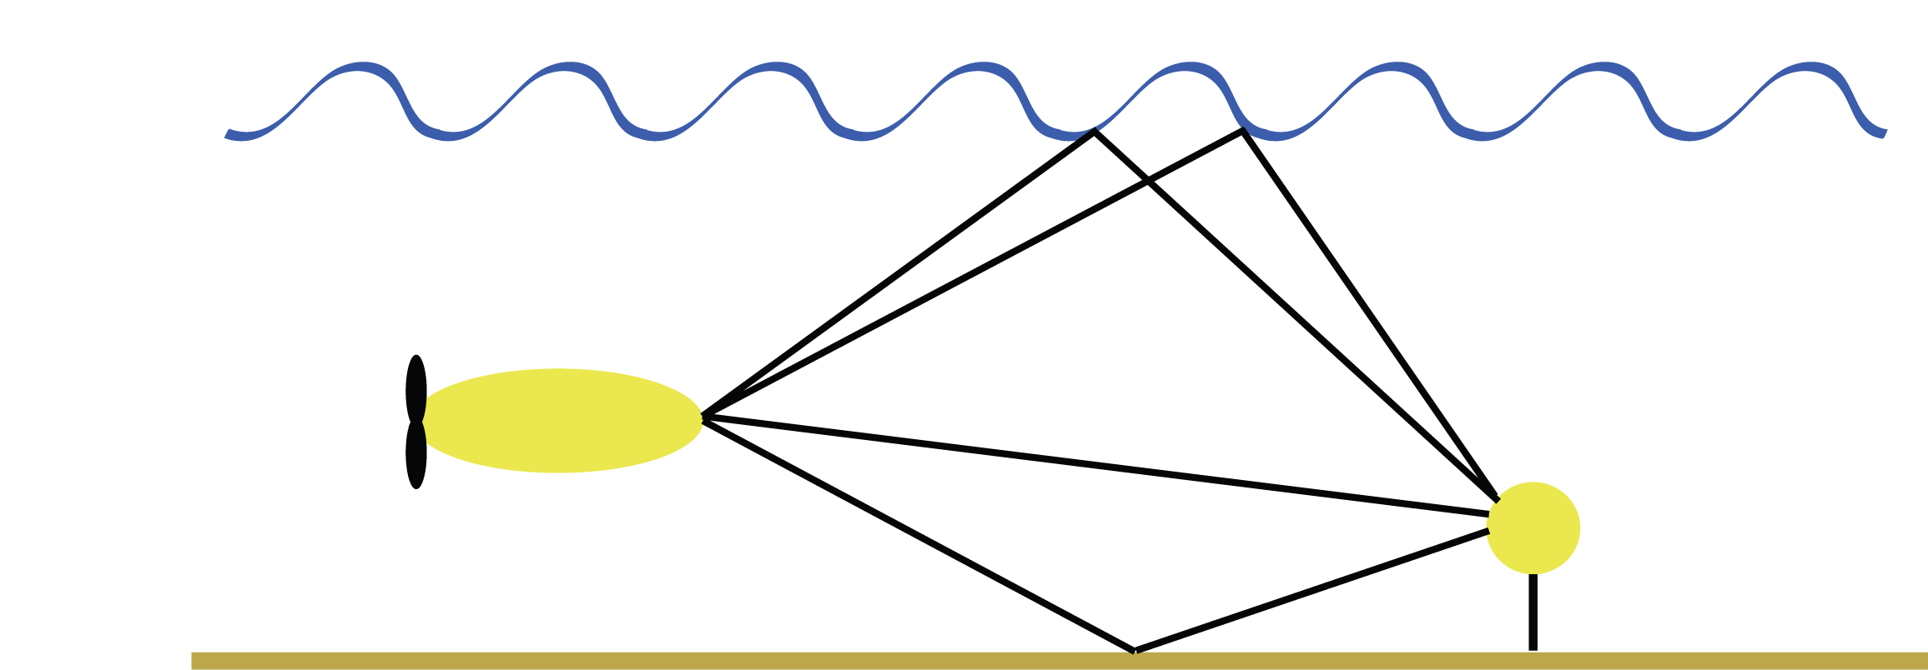
Comparison and Analysis of Equalization Techniques for the Time-Varying Underwater Acoustic Channel
Ballard Blair
bjblair@mit.edu
PhD Candidate
MIT/WHOI Joint Program
Advisor: Jim Presisig

Slide 2
Outline
Introduction:
Underwater Communication
Decision Feedback Equalization
Channel Estimate Based
Direct Adaptation
Analysis of Equalization Behavior
Simulation Results
Summary and Conclusion
Future Directions

Slide 3
Underwater Communication

Slide 4
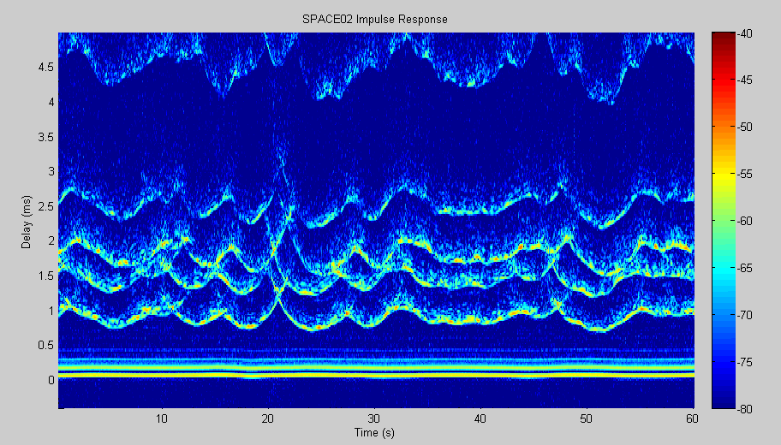
Time Varying Impulse Response

Slide 5
Channel Model
Baseband noise
Transmitted Data
+
Baseband Received Data
Time-varying, linear baseband channel

Slide 6
Channel Model (cont.)
Vector-form:
d[n-N_{c}+1]
…
d[n]
…
d[n+N_{a}]
g*[n,-N_{c}+1] g*[n,N_{c}+2] … g*[n,0] … g*[n,N_{a}]
+
Matrix Vector-form:
v[n-L_{c}+1]
…
v[n]
…
v[n+L_{a}]
d[n-L_{c}-N_{c}+1]
d[n-L_{c}-N_{c}+2]
…
d[n]
…
d[n+L_{a}+N_{a}-1]
d[n+L_{a}+N_{a}]
g*[n-L_{c}+1,N_{c}-1] … g*[n-L_{c}+1,0] … g*[n-L_{c}+1,N_{a}] 0 0 … 0
0 g*[n-L_{c}+2,N_{c}-1] … g*[n-L_{c}+2,0] … g*[n-L_{c}+2,N_{a}] 0 … 0
…
0 ..0 g*[n+L_{a}-1,N_{c}-1] … g*[n-L_{a}-1,0] … g*[n+L_{a}-1,N_{a}] 0
0 ..0 0 0 0 0 g*[n+L_{a},N_{c}-1] … g*[n-L_{a},0] … g*[n+L_{a},N_{a}]
u[n-L_{c}+1]
…
u[n]
…
u[n+L_{a}]
+

Slide 7
Equalization
TX Data bit (linear) estimator:
Vector of RX data and TX data estimates
LMMSE Optimization:
Solution:
Recursive Processing (lag 1):

Slide 8
Decision Feedback Equalizer (DFE)
Two Parts:
(Linear) feed-forward filter (of RX data)
(Linear) feedback filter (of data estimates)
Estimate using RX data and TX data estimates
Split Channel convolution Matrix:
Received data becomes:
Minimum Achievable Error:

Slide 9
DFE: Direct Adaptation

Slide 10
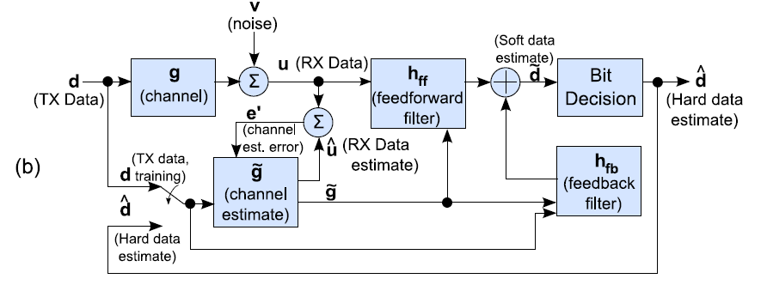
DFE: Channel Estimate

Slide 11
Assumptions
Unit variance, white transmit data
TX data and obs. noise are uncorrelated
Obs. Noise variance:
Perfect data estimation (for feedback)
Equalizer Length = Estimated Channel Length
N_{a} + N_{c} = L_{a} + L_{c}
MMSE Equalizer Coefficients have form:

Slide 12
Comparison between DA and CEB
In the past, CEB methods empirically shown to have lower mean squared error at high SNR
Reasons for difference varied:
Condition number of correlation matrix
Number of samples required to get good est.
Analysis to follow: low and high SNR regimes

Slide 13
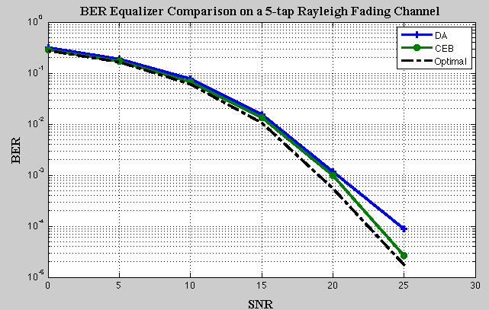
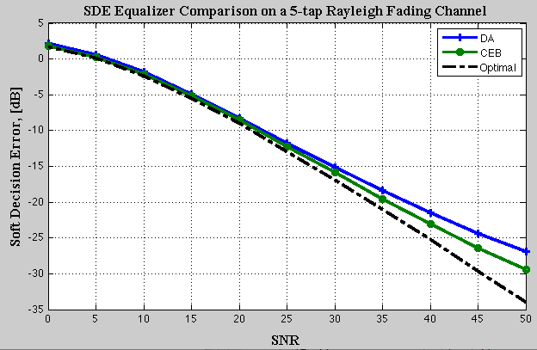
Comparison of DA and CEB on Rayleigh Fading Channel

Slide 14
Why the difference?
Correlation time
DA equalizer taps have lower correlation time at high SNR
At low SNR, two methods equivalent
But how do we show this?
Combination of analysis and simulation

Slide 15
AR channel model
Simple channel model to analyze
Similar to encountered situations

Slide 16
Low SNR

Slide 17
High SNR

Slide 18
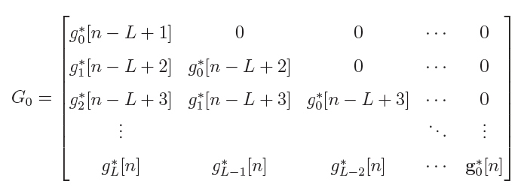
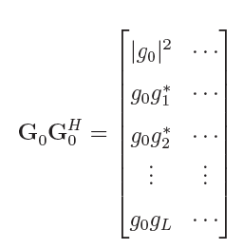
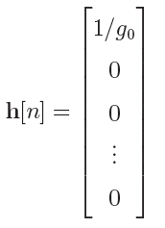

Slide 19
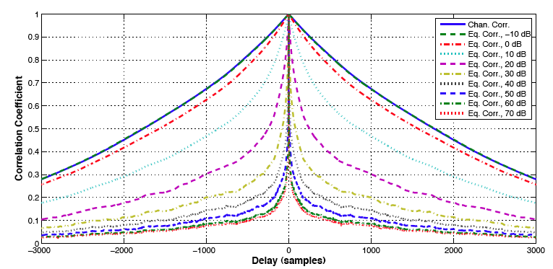
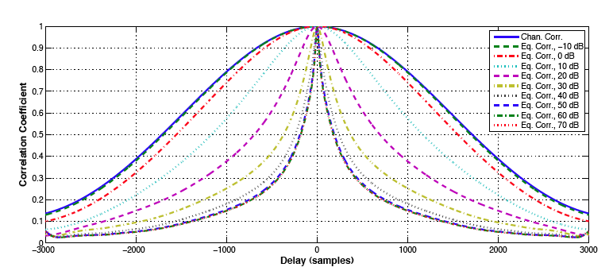
Correlation over SNR
AR(1)model
Gaussian model

Slide 20
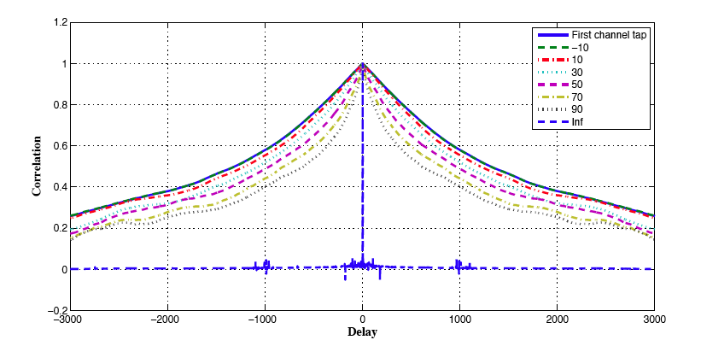
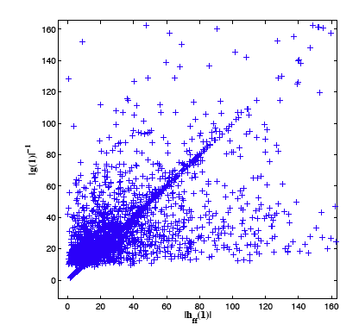
Multi-tap
AR(1)model

Slide 21
Conclusions
As SNR increases, correlation time of equalizer taps is reduced
CEB is tracking value correlated over longer time
DA should do worse
Assumed noise statistics were stationary
Not always case in underwater
Underwater communication is power limited
Operate in low SNR regime (<35dB)

Slide 22
Future Work
Include channel state information into DA
Sparsity
Reduce number of snapshots for channel model
Physical constraints?
Compressed sensing?

Slide 23
Questions?

